Slide 1
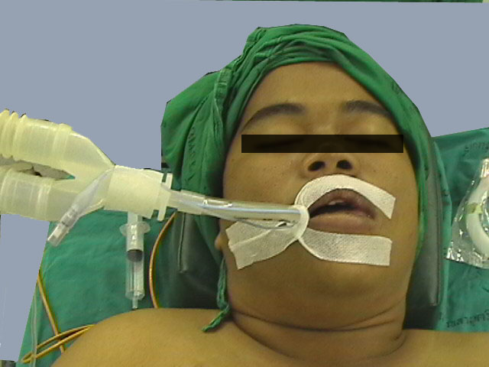
Airway management – Part II
The technique of tracheal intubation , laryngoscopes and type of blades.
Ahmad Al Rimawi

Slide 2
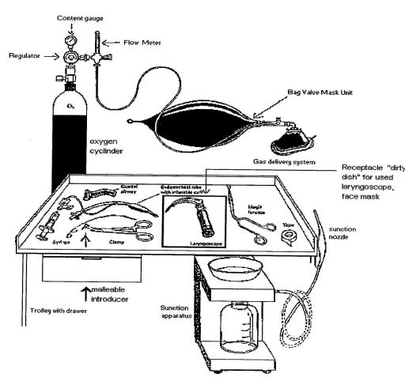
Equipment Required for Successful Intubation

Slide 3
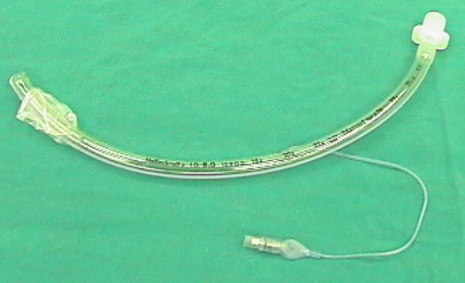
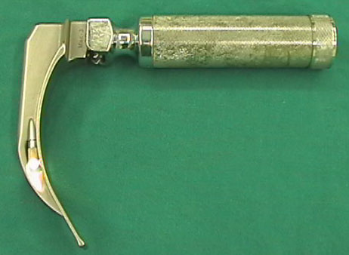
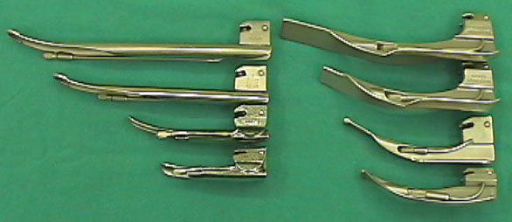
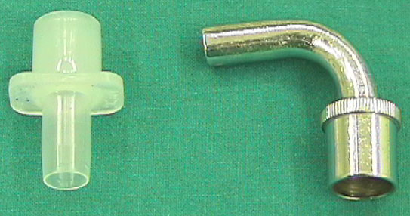
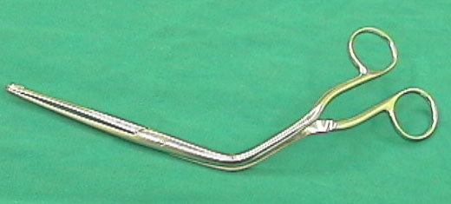
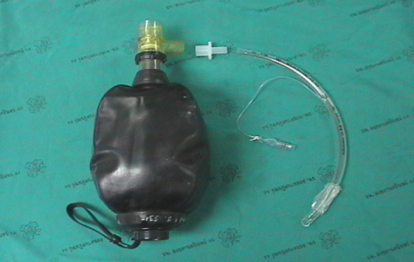
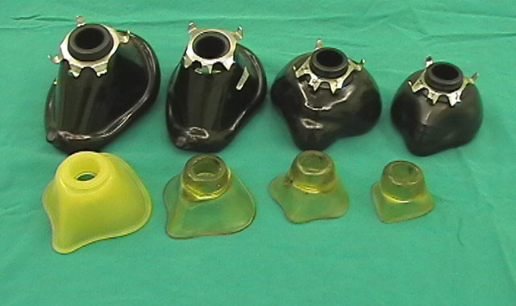
Equipment Cont…
we will discuss later on
Laryngoscope with relevant size blades.
Magill forceps.
Flexible introducer.
10-20 ml syringe.
Oropharangeal airways – all sizes.
Tape or adhesive plaster.
E.T tubes – relevant sizes.
Bag-valve-mask with oxygen connected.
Suction unit with Yankauer nozzle and endotracheal suction catheter.
Miller blade
Macintosh blade

Slide 4
Technique of Endotracheal Intubation
The following 5 Steps:
1. Positioning the patient.
2. Opening the patient's mouth.
3. Performing Laryngoscopy.
4. Insertion of the Tube through the vocal cords and removing the laryngoscope.
5. Confirmation of the correct placement and securing the tube.

Slide 5
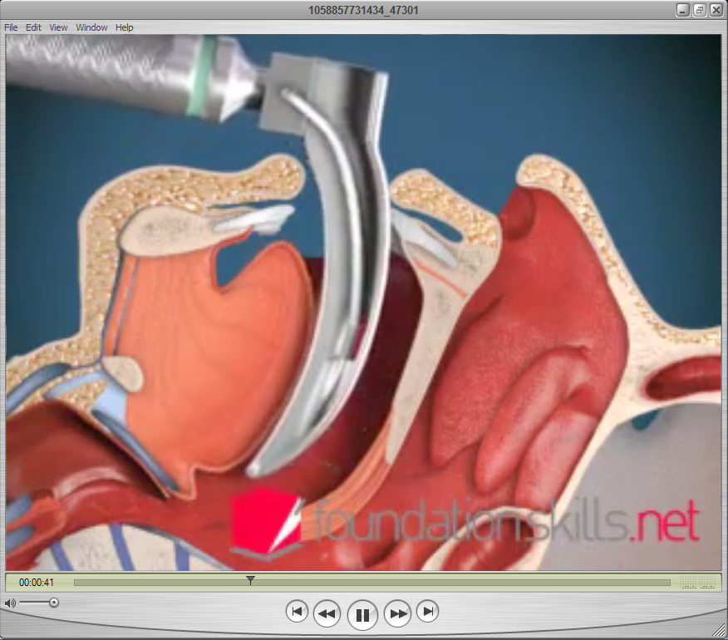

This Video is available on our Group
website ::
GroupD2
.yolasite.com
iPad - friendly

Slide 6
Technique Cont…
Position the patient supine, open the airway with a head-tilt chin-lift maneuver.(Suspected spinal injury, attempt naso-tracheal intubation, spine in neutral position).
Open mouth by separating the lips and pulling on upper jaw with the index finger.
Hold laryngoscope in left hand, insert scope into mouth with blade directed to right tonsil.
Once right tonsil is reached, sweep the blade to the midline keeping the tongue on the left.

Slide 7
Technique Cont…
This brings the epiglottis into view.” DO NOT LOOSE SIGHT OF IT!”
Advance the blade until it reaches the angle between the base of the tongue and epiglottis.( volecular space)
Lift the laryngoscope upwards and away from the nose – towards the chest. This should bring the vocal cords into view. It may be necessary for a colleague to press on the trachea to improve the view of the larynx.
Place the ETT in the right hand. Keep the concavity of the tube facing the right side of the mouth.
Insert the tube watching it enter through the cords.

Slide 8
Technique Cont…
Insert the tube just so the cuff has passed the cords and then inflate the cuff.
Listed for air entry at both apices and both axillae to ensure correct placement using a stethoscope.

Slide 9
Rules of Intubation
Always have a suction unit available.
An intubation attempt should never exceed 30 seconds.
Oxygenate the patient pre and post intubation with a bag-valve-mask.(100% O2).
Have sedative medication available if needed. (e.g. Midazolam 15mg/3ml)
Always recheck tube placement manually guided by oxygen saturation readings.(Spo2).

Slide 10
4 Rules of Suctioning
Never suction further than you can see.
Always suction on the way out.
Never suction for longer than15 seconds.
Always oxygenate the patient before and after suctioning.

Slide 11
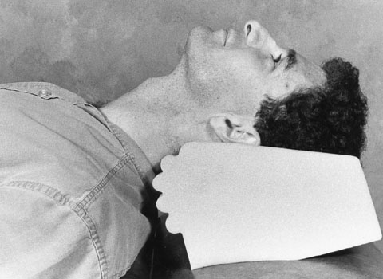
Step 1:
Positioning the patient.
(Sniffing position)
(sniffing the morning air position)

Slide 12
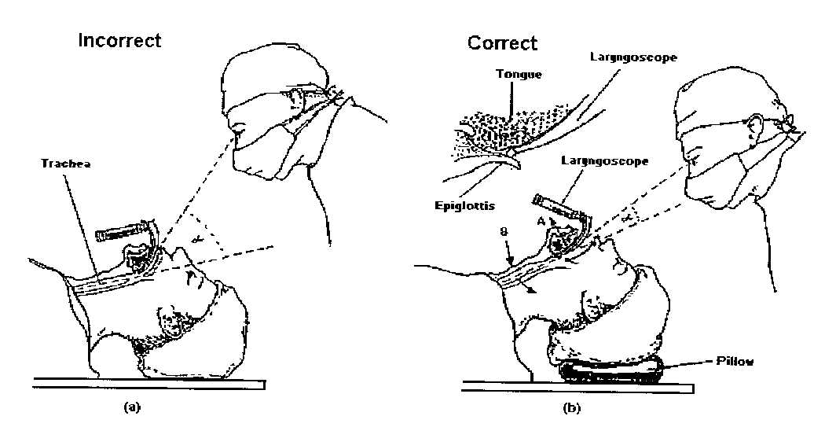
Step 1: Positioning the patient. (Sniffing position)
Flexion at lower cervical spine + Extension at atlanto-occipital joint

Slide 13
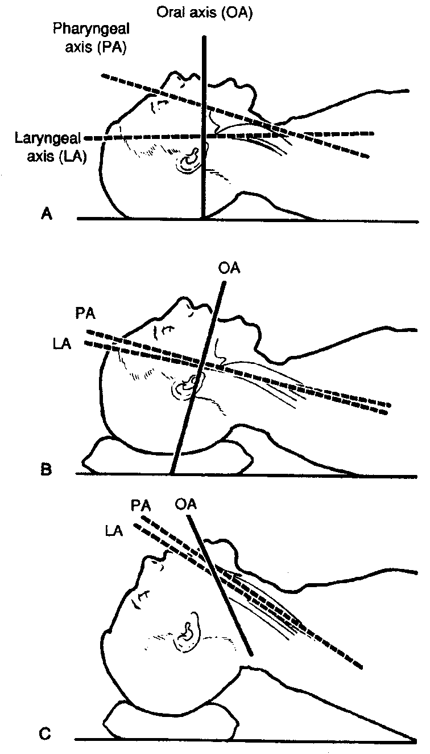
Atlanto-occipital extension alone increases the angle between the axes of the pharynx and the larynx
WHILE
The combination of cervical flexion of the neck with atlanto-occipital extension result in the alignment of the axes of the pharynx and larynx.

Slide 14
Step 2: Opening the patient's mouth.
Position of the Anesthesiologist …behind the patient’s head
Laryngoscope: in the left hand
Scissor maneuver:
Using the index finger to pull the upper right incisors towards the operator.. this serves to open the mouth, extends the AO joint, and protects the teeth and lips. At the same time, the thumb depresses the lower mandible, further opening the mouth.
Modified Scissor maneuver:
Opening the patient’s mouth using one’s right middle finger to depress the lower teeth.
The right hand is placed on the patient’s occiput and the patient’s head is rotated into the sniffing position.
This method is more suitable for edentulous patient.

Slide 15
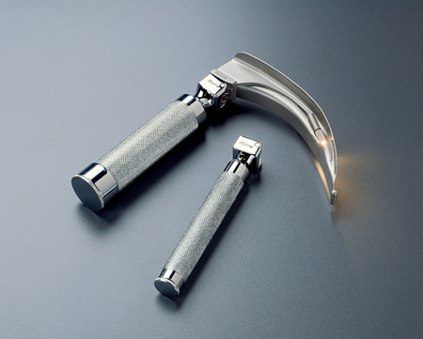
Step 3: Performing Laryngoscopy.
1. The Laryngoscope’s function is to visualize the mouth/Pharynx/Epiglottis
2. With your left hand insert the Blade to the right of the tongue so that the tongue moves toward the left
3. Once the tip of the blade is at the base of the tongue pull the laryngoscope forward and upward in 45 degree from the horizontal line(don’t rotate as you might damage the upper teeth).
4. Don’t approach your face to the patient to allow the arms to exert traction on the laryngoscope rather than attempting to lift the laryngoscope with the wrist.

Slide 16
Laryngoscope

Slide 17
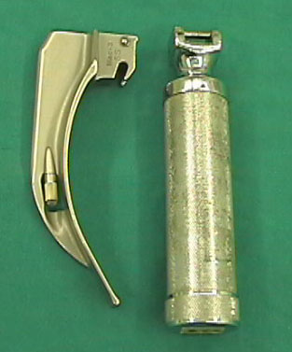
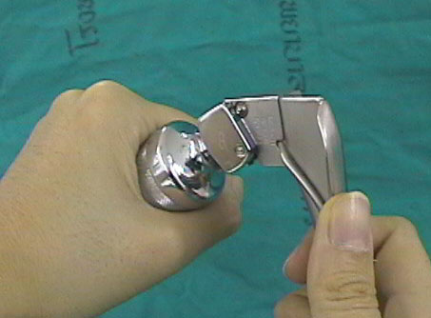
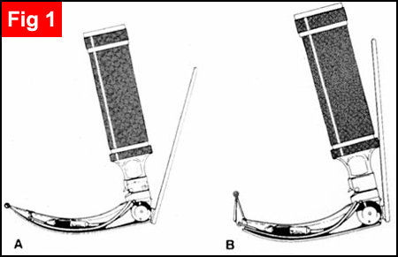
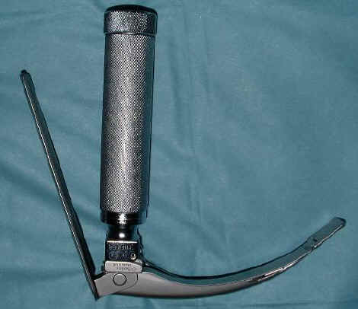
Conventional laryngoscope
Handle and Blade
McCoy
laryngoscope

Slide 18
LARYNGOSCOPIC BLADE
Macintosh (curved) and Miller (straight) blade
Adult : Macintosh blade, small children : Miller blade
Miller blade
Macintosh blade

Slide 19
The Macintosh blade is positioned in the vallecula, anterior to the epiglottis, lifting it out of the visual pathway.
The Miller blade is positioned posterior to the epiglottis, trapping it while exposing the glottis and vocal folds.
Incorrect usage can cause trauma to the front incisors; the correct technique is to displace the chin upwards and forward at the same time, not to use the blade as a lever with the teeth serving as the fulcrum.
Laryngoscopes with a straight Blade, the blade is difficult to control in adult humans and can cause pressure on the vagus nerve, which can cause unexpected cardiac arrhythmias to spontaneously occur in adults.

Slide 20
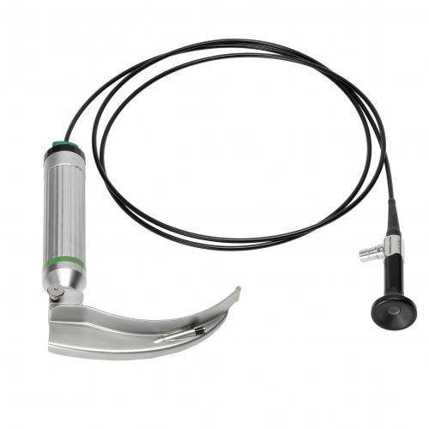
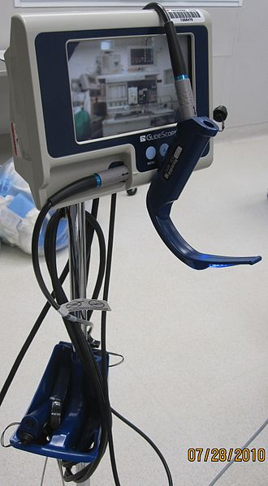
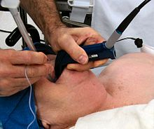
Indirect laryngoscopy
Fiberoptic laryngoscopes
Video laryngoscope
Glidescope :
The steep 60-degree angulation of its blade improves the view of the glottis by reducing the requirement for anterior displacement of the tongue.
The video camera has a relatively wide viewing angle of 50 degrees.
The heated lens innovation helps to prevent fogging of the lens, which might otherwise obscure the view.

Slide 21
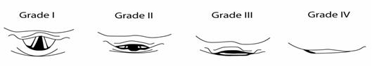
Laryngoscopy according to the Cormack and Lehane classification:
Grade I: complete glottis visible
Grade II: anterior glottis not seen
Grade III: epiglottis seen, but not glottis
Grade IV: epiglottis not seen

Slide 22
Step 4: Insertion of the Tube through the vocal cords and removing the laryngoscope.
With the right hand insert the tube till the cuff passes through the vocal cords .
Remove the laryngoscpe .
Inflate the cuff with 15ml of Air ( to prevent Air leaking during ventilation ) .
Attachment the tube to Bag-valve-mask with O2 flow between 12-15 L/min .

Slide 23
Step 5: Confirmation of the correct placement and securing the tube.
Immediate absolute proof:
1. Observing the Tube passing through the vocal cords
2. Observing carbon dioxide (ETCO2)
3. Visualizing the tracheal lumen using fiberoptic scope
Indirect confirmation
1. Listening over the epigastrium (absence of breath sounds with ventilation)
2. Observing the chest to raise and fall with positive pressure ventilation
3. Listening to the apex & axillae of each lung for breath sounds with ventilation
*on A-P CXR the tip of ETT should be between the midpoint of the thoracic inlet & the carina

